Slide 1

Asersi Manajemen dan Siklus Penjualan
Teknik Audit Berbantuan Komputer
Minggu ke-13

Slide 2
Asersi Manajemen
Siklus Penjualan
Latihan Uji Substantif

Slide 3
Cakupan Pembelajaran TABK
Konsep Audit
Jenis Audit
Tahap Audit
Peran TABK
1
9-10
Konsep Audit dan TABK
Data, Tabel, dan Query
Pemanfaatan SQL untuk Audit
Konsep Pengolahan Data
Fungsi Pengolahan Data
Pengolahan Data Elektronik
2
11-12
Pengujian Analitik dan Sampling
Konsep Pengujian Analitik
Konsep Sampling
Praktik
Konsep Pengendalian Aplikasi
Data Validation (Ms. Excel)
Studi Kasus
3-4
13
Asersi Manajemen
Konsep Audit Siklus Penjualan
Praktik
Pengendalian Aplikasi
Uji Substantif:
Siklus Penjualan
Impor – Ekspor data (Ms. Excel)
Menguji Hasil Impor
Impor dan Ekspor Data
5
14
Uji Substantif:
Siklus Pembelian
Konsep Audit Siklus Pembelian
Praktik
Konsep Simulasi Sejajar
Praktik Simulasi Sejajar
Uji Substantif:
Simulasi Sejajar
6-7
15
Uji Substantif:
Kas dan Aset Tetap
Konsep Audit Kas
Konsep Audit Aset Tetap
Praktik
Ujian Tengah Semester
8
16
Ujian Akhir Semester

Slide 4
Asersi Manajemen

Slide 5
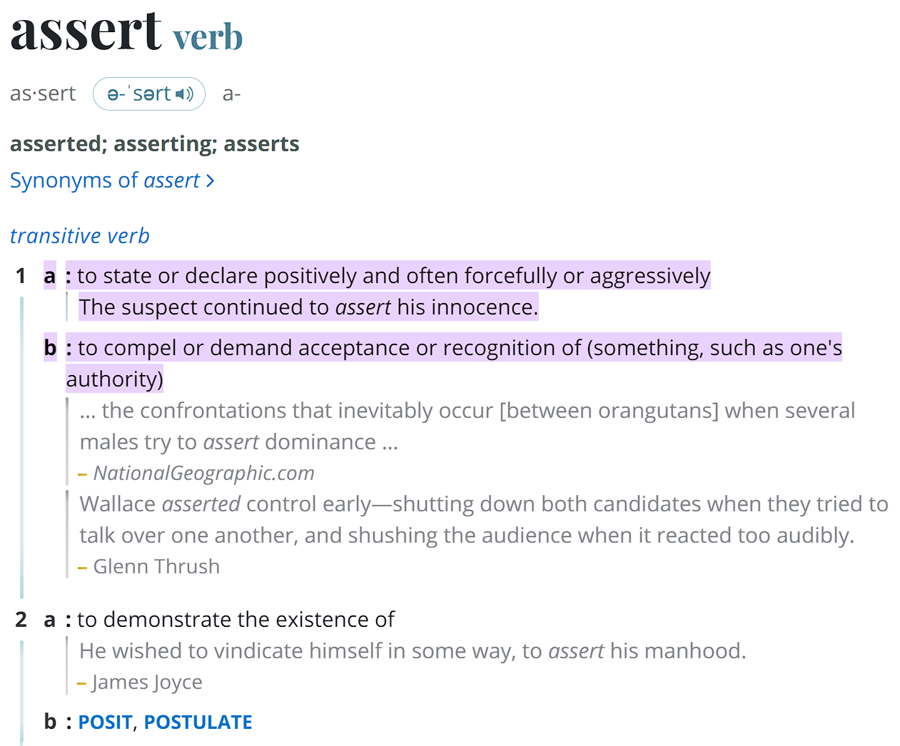
Sumber:
https://www.merriam-webster.com/dictionary/assert

Slide 6
Asersi Manajemen (laporan keuangan)
Pernyataan yang dibuat oleh manajemen (secara eksplisit maupun implisit) bahwa laporan keuangan yang dibuat telah sesuai dengan prinsip akuntansi yang berlaku umum

Slide 7
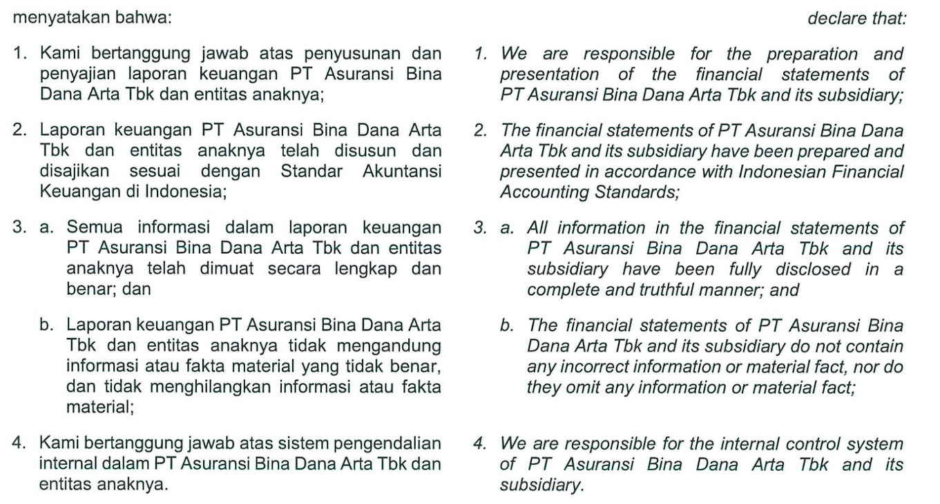
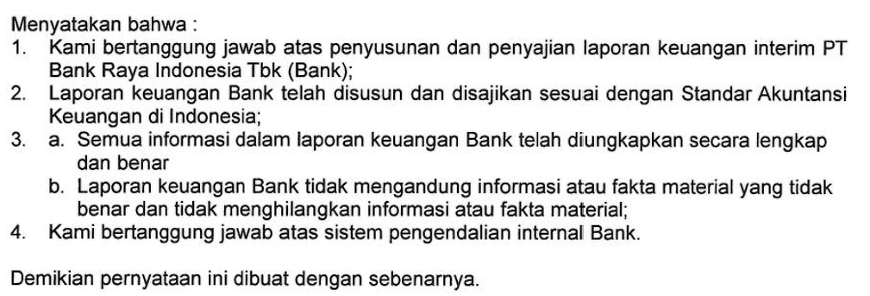
Contoh Asersi Eksplisit

Slide 8
Klasifikasi Asersi

Slide 9
Peran Auditor

Slide 10
Klasifikasi Asersi dan Siklus Akuntansi
 | Penjualan | Pembelian | Kas | Aset Tetap

Slide 11
Siklus Penjualan

Slide 12
Contoh Siklus Penjualan - Pendapatan
Bank Rec
Start Here
Payments
Purchase Order
Cash Collection
Collections
Customer Orders
Sales Invoice
Cash Receipts Recording
Acc Rec Recording
Sales Authorization
Physical Custody
Bill Customers
Warehousing Shipping and Delivery
Credit Granting
Bill of Lading
Credit
Inventory

Slide 13
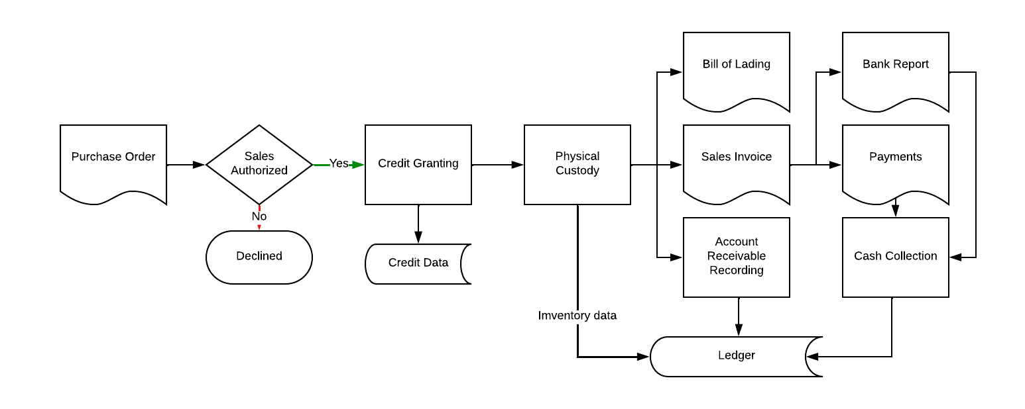
Contoh Siklus Penjualan

Slide 14
Kriteria Umum Pengakuan Pendapatan
Persuasive evidence of an arrangement exists.
Delivery has occurred, or services have been rendered.
The seller’s price to the buyer is fixed or determinable.
Collectability is reasonably assured.

Slide 15
Contoh Kasus Fraud
1. early revenue recognition;
2. holding the books open past the accounting period;
3. fictitious sales;
4. failure to record returns;
5. fraud in the percentage of completion method;
6. related-party transactions;
7. overstating receivables and inventory; and
8. liability and expense omissions.

Slide 16
Contoh Skema Fraud
Recognition of revenue on shipments that never occurred
Hidden side letters, agreements containing contract terms that are not part of the formal contract, giving customers an irrevocable right to return the product
Recording consignment sales as final sales
Early recognition of sales that occurred after the end of the fiscal period
Shipment of unfinished product
Shipment of product before customers wanted or agreed to delivery
Creation of fictitious invoices
Shipment of more product than the customer ordered
Recording shipments to the company’s own warehouse as sales
Shipping goods that had been returned and recording the reshipment as a sale of new goods before issuing credit for the returned sale
Incorrect aging of accounts receivable and not recording write-downs of potentially uncollectible amounts
Recording purchase orders as completed sales

Slide 17
Assertions about Classes of Transactions
Occurrence. All revenue and cash receipt transactions and events that have been recorded have occurred and pertain to the entity.
Completeness. All revenue and cash receipt transactions and events that should have been recorded have been recorded.
Authorization. All revenue and cash receipt transactions and events are properly authorized.
Accuracy. Amounts and other data relating to recorded revenue and cash receipt transactions and events have been recorded appropriately.
Cutoff. All revenue and cash receipt transactions and events have been recorded in the correct accounting period.
Classification. All revenue and cash receipt transactions and events have been recorded in the proper accounts.

